Slide 1
Ohio Politics & Higher Education
John T. McNay, Ph.D. President, Ohio Conference AAUP
Sara Kilpatrick Executive Director, Ohio Conference AAUP

Slide 2
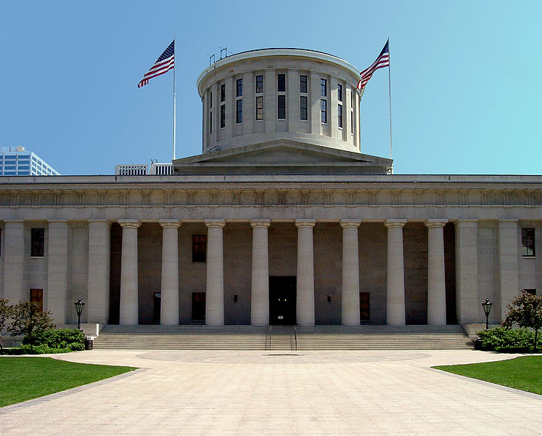
Ohio Government
Gov. John Kasich (R)
Ohio House: 66 R – 33 D
Ohio Senate: 24 R – 9 D
Veto-proof majorities
House: Higher Ed Finance Subcommittee, Standing Committee
Senate: Higher Ed Finance Subcommittee
Chancellor Carey & Ohio Department of Higher Education
Other stakeholders:
Bruce Johnson, Inter-University Council
Jack Hershey, Ohio Association of Community Colleges
Allies: Ohio Faculty Council, Ohio Faculty Senate, Ohio Education Association, Ohio Federation of Teachers

Slide 3
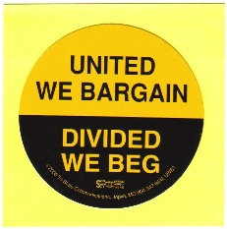
Issues
Collective Bargaining
Funding
Workload
Textbooks
“Affordability & Efficiency”
Privatization
“Campus-Carry”
Public Pensions
Tenure

Slide 4
Current Legislation of Importance
HB 49: State Budget Bill
SSI Funding: 1% increases each year
OCOG Funding: 3.1% increase in FY 18; 2% increase in FY 19
Textbooks: Colleges and universities must provide; can charge students $300/year
“’textbook’ means any required instructional tools, such as bound and electronic textbooks and software, used specifically for curricular content instruction in a course”
Problems:
Unfunded mandate that would cost institutions millions in textbook and administrative costs
Some students would end up subsidizing others
Doesn’t address costs of textbooks, simply shifts the costs from students to institutions
Academic freedom

Slide 5
Current Legislation of Importance
HB 49: State Budget Bill
Tenure: “The board of trustees of each state institution of higher education shall review the institution's policy on faculty tenure and update that policy to promote excellence in instruction, research, service, and commercialization.” “Beginning on January 1, 2018, as a condition for a state institution of higher education to receive any state funds for research that are allocated to the department of higher education under the appropriation line items referred to as either "research incentive third frontier fund" or "research incentive third frontier-tax," the chancellor shall require the state institution to include a commercialization pathway for faculty tenure in its policy.”
College credit for work experience/apprenticeships for high school students
Western Governors University: Status as an Ohio institution

Slide 6
Other Legislation
HB 53: “Right-to-work” – public sector (Rep. Becker)
Unions cannot charge agency/fair share fees
Unions wouldn’t be required to represent non-members
Would give management ability to “divide and conquer”
HB 113 (Rep. Brinkman): RTW for private sector
HB 66: Tenured Faculty Workload Mandate (Rep. Young)
Tenured faculty would have to teach at least one undergraduate course per semester
Rep. Roegner bill: eliminate tenure for new faculty

Slide 7
Our Legislative Agenda & 2017 Report

Slide 8
Overarching Legislative Goals
Help decision-makers understand real problems in higher ed & Deter them from “Band-Aid” approaches through lobbying and testimony
Offer concrete solutions of our own
Promote and defend academic freedom and tenure
Engage public through op-eds and social media
Use Higher Education Report as lobbying tool

Slide 9
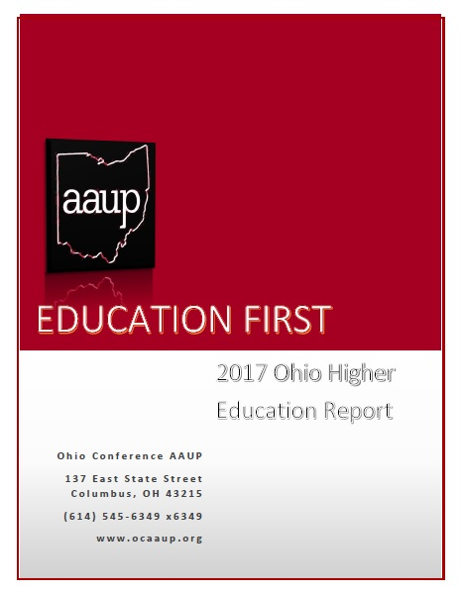
2017 Higher Education Report
We address:
Inadequate state funding
CCP & CBE as gimmicks
Construction debt & Athletic deficit spending
Reforming and diversifying boards of trustees
Converting adjunct positions to full-time ones

Slide 10
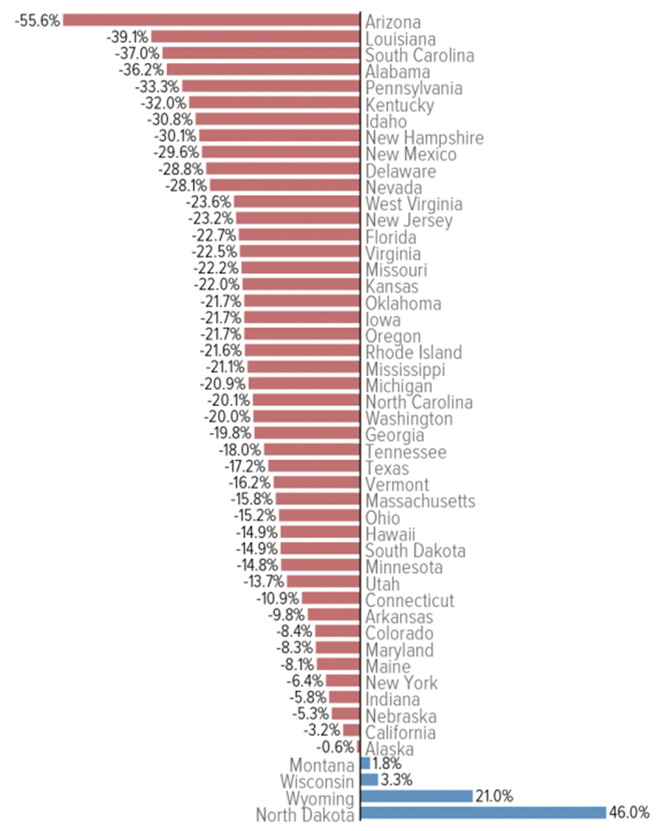
Bringing Attention to Real Problems
Lack of State Funding
% change in spending per student, inflation adjusted, FY 08-16

Slide 11
CCP & CBE
College Credit Plus
Students as early as 7th grade
Delivery methods: 1) high school teacher in high school, 2) faculty at the college, 3) faculty at the high school, 4) online
ODHE Data:
.5 higher GPAs than undergrads in same courses
Students taught in high school by high school teachers have higher GPAs
Quality?
Financial impact on colleges and universities
Competency-Based Education
OK in certain areas
Could create more disparity

Slide 12
Bringing Attention to Real Problems
Deep in Debt: The Building Boom
University | 2005 Debt | 2015 Debt | % Change
The Ohio State University | $877,540,000 | $2,743,351,000 | 213%
University of Cincinnati | $877,453,000 | $1,060,120,000 | 21%
Miami University | $168,613,252 | $622,306,800 | 269%
Ohio University | $167,529,147 | $543,347,988 | 224%
Kent State University | $279,692,000 | $505,173,000 | 81%
The University of Akron | $258,484,797 | $453,581,325 | 75%
The University of Toledo | $176,779,000 | $298,187,000 | 69%
Cleveland State University | $115,923,075 | $239,322,461 | 106%
Bowling Green State University | $109,000,000 | $134,457,569 | 23%
Wright State University | $46,189,820 | $95,429,869 | 107%
Youngstown State University | $13,268,653 | $67,819,444 | 411%
Northeast Ohio Medical University | $1,046,607 | $43,012,814 | 4010%
Central State University | $2,340,402 | $16,403,259 | 601%
TOTAL | $3,093,859,753 | $6,822,512,529 | 121%

Slide 13
Bringing Attention to Real Problems
Athletic Spending

Slide 14
Bringing Attention to Real Problems
Administrative Bloat
1 Admin : 14 Students
1 Admin : 1 Full-Time Faculty

Slide 15
Bringing Attention to Real Problems
University Trustees
Public/NP

Slide 16
Bringing Attention to Real Problems
Overuse of Adjunct Faculty
Do universities really need so many adjuncts?
By cutting just a small amount of expenses in other areas and shifting them to instruction, universities could phase in more full-time faculty positions
Costs of Converting Part-Time Faculty to Full-Time Positions
Institution | Part-Time Faculty | % of Faculty in Part-Time Positions | Cost of Converting 50% of Part-Time Faculty to Asst. Professorships as a % of Total Expenditures | Cost of Converting 50% of Part-Time Faculty to Instructorships as a % of Total Expenditures
Bowling Green | 433 | 34.95% | 4.51% | 3.68%
Central State | 89 | 46.35% | 5.31% | 4.00%
Cleveland State | 608 | 51.88% | 9.58% | 8.99%
Kent State | 1337 | 48.06% | 7.54% | 6.04%
Miami U | 477 | 30.29% | 3.94% | 2.22%
Ohio State | 1813 | 42.02% | 1.55% | 2.13%
Ohio U | 869 | 43.47% | 4.90% | 4.47%
Shawnee State | 161 | 51.94% | 9.54% | 7.10%
Akron | 936 | 51.68% | 8.73% | 7.52%
Cincinnati | 1250 | 43.97% | 4.55% | 3.25%
Toledo | 317 | 26.48% | 1.79% | 1.34%
Wright State | 165 | 17.76% | 1.91% | 1.23%
Youngstown State | 565 | 56.27% | 11.10% | 8.50%

Slide 17
How You Can Help
Get involved with your local chapter and/or State Conference
Get other faculty active and engaged; raise awareness on campus
Respond to legislative alerts
Help us lobby in Columbus

Slide 18
Contact Us
John McNay: john.mcnay@uc.edu
Sara Kilpatrick: sara@ocaaup.org

